Slide 1
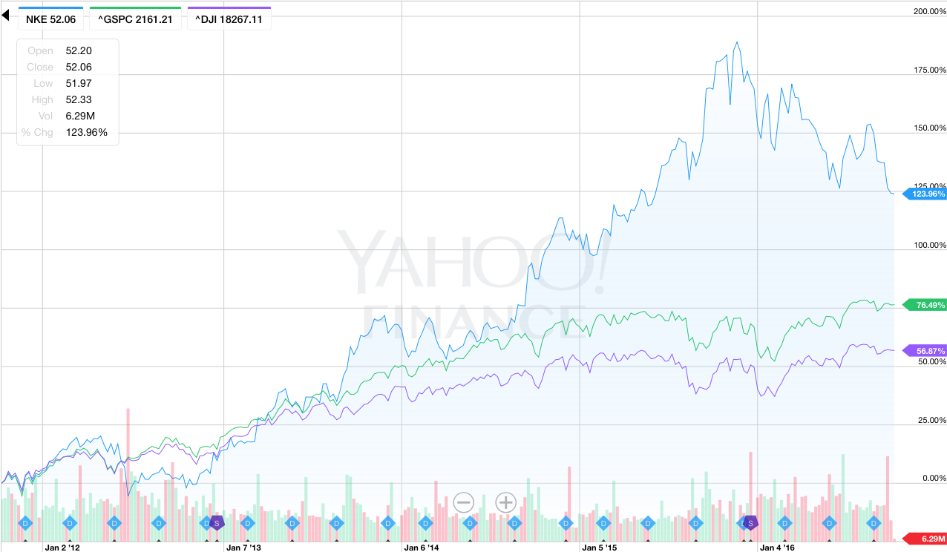
Nvidia Inc. (NVDA)
Arman Hastings
October 13, 2016 Large Cap Portfolio

Slide 2
Corporate Governance
Founders:
Jen-Hsun Huang - Founder, President and CEO
Chris Malachowsky - Founder and NVIDIA Advisor
Colette Kress – CFO
Jay Puri – Worldwide Field Operations
David M. Shannon - Administration officer and Secretary
Debora Shoquist - Operations
ISS Governance Score- 5
Audit – 1
Board Structure – 4
Shareholder Rights – 6
Compensation – 6

Slide 3
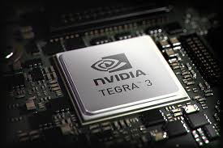
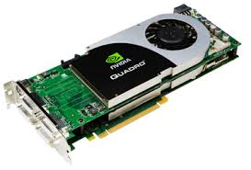
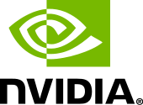
Business Overview
American technology company based in Santa Clara, California
Founded in 1993, 23 years ago
Created the GPU
Since 2014, Nvidia has shifted to become a platform company focused on four markets — Gaming, Professional Visualization, Data Centers and Auto.

Slide 4
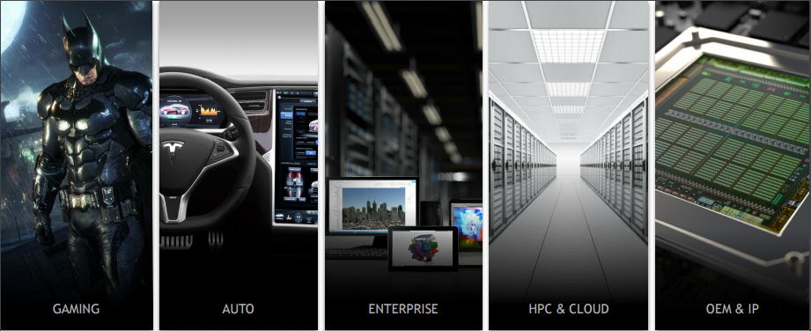
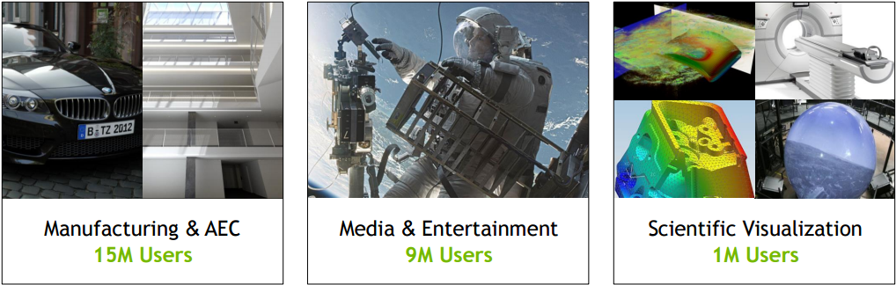
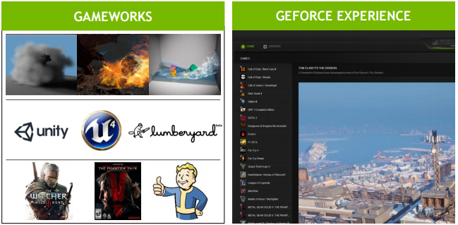
Business Avenues

Slide 5
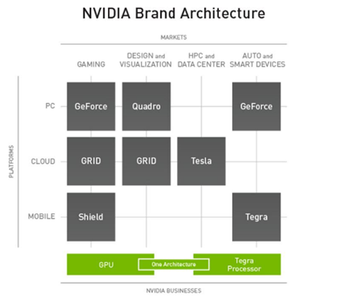
Business Overview
Nvidia’s Products
GPU Related:
Gaming
Design and Visualization
Tegra Processor Related:
HPC and Data Center
Auto Smart Devices

Slide 6
Business Overview
Taiwan | 34.06%
China | 19.70%
United states | 16.89.%
Other Asia | 13.61%
Europe | 7.88%
Other Americas | 7.87%

Slide 7
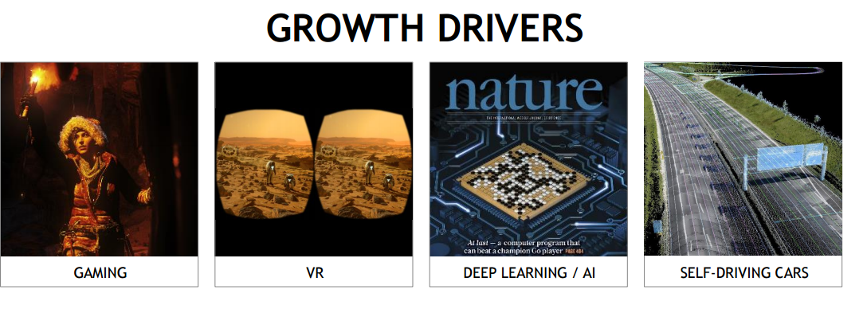
Competitive Positioning
Foundational competitive advantage of being the creators of the GPU
much more invested in research and development than their direct competitors.
NVidias better processor cooling, lower power consumption and
overclocking potential, but are not as cheap as alternatives
Very strong branding and marketing. Maintaining a good relationship with customer
Base
Innovative products, high barriers to entry and limited direct competitors for their
New focuses on Deep learning, AI, automotive, gaming, and professional graphics

Slide 8
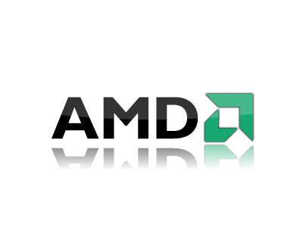
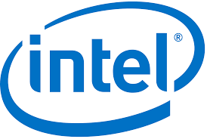
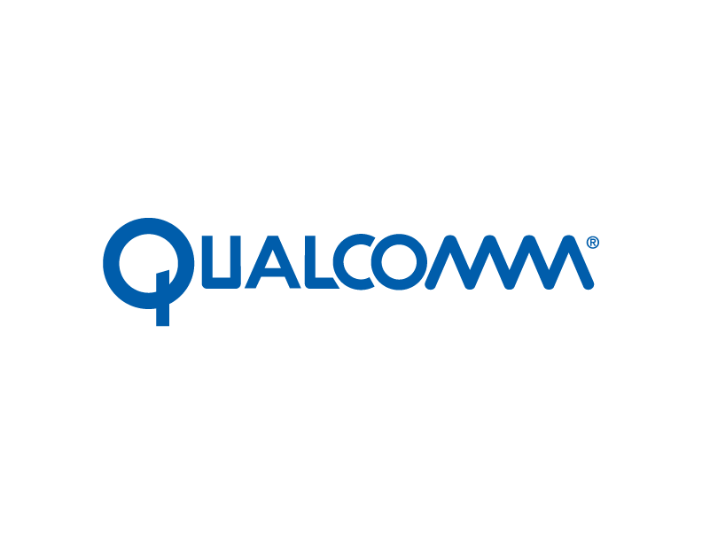
Competitors
AMD – AMD competes directly with Nvidia in the Gaming market. AMD sells GPU’s as well as a larger array of semiconductor products
Intel – A conglomerate of well known footwear and apparel companies, VFC competes with Nike in their sportswear category across the globe
Qualcomm – Under Armour competes directly with Nike, especially in North America. UA has made significant strides lately in capturing the performance market

Slide 9
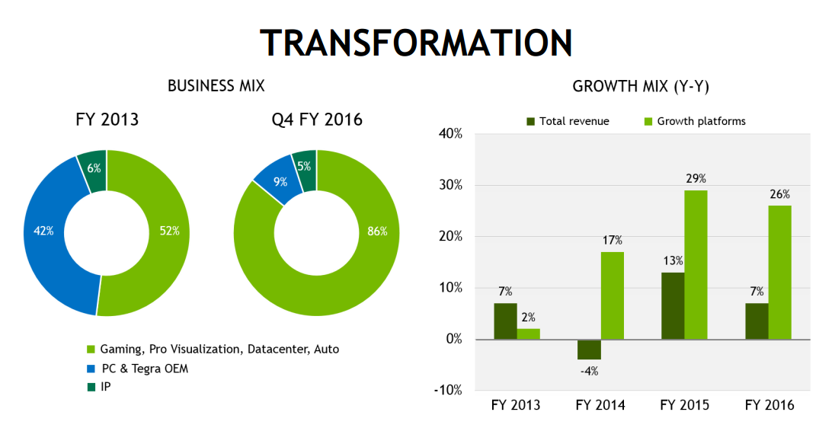
Competitive Positioning

Slide 10
SWOT Analysis
Strengths
- A Strong Market position and popular branding & advertising
- Good product mix in graphical processing units.
- Top performers and well known for their GeForce, Quadro, Tegra, and Tesla lines.
- Software changes are easy to develop and integrate when their GPU’s and Tegra’s are already widely implemented.
Weaknesses
- Intense competition and change within the fast pace sector
- Interest rate increases as they just started taking on short term debt
- Majority of revenue from their GeForce GPU line
Opportunities
- Opportunities is automobile growth as more cars are equipped with computers, screens and eventually artificial intelligences for driving.
- Growing industry desire for Deep Learning, Artificial intelligences, and super computing
- Increase in the Cloud Computing market
- Innovation for PC, Mobile, and cloud products and services
Threats
- Intense GPU competition from other major brands.
- Economic slowdown and fluctuations
- Reduction in general technological development
- Reduction in market share

Slide 11
Financial Performance

Slide 12
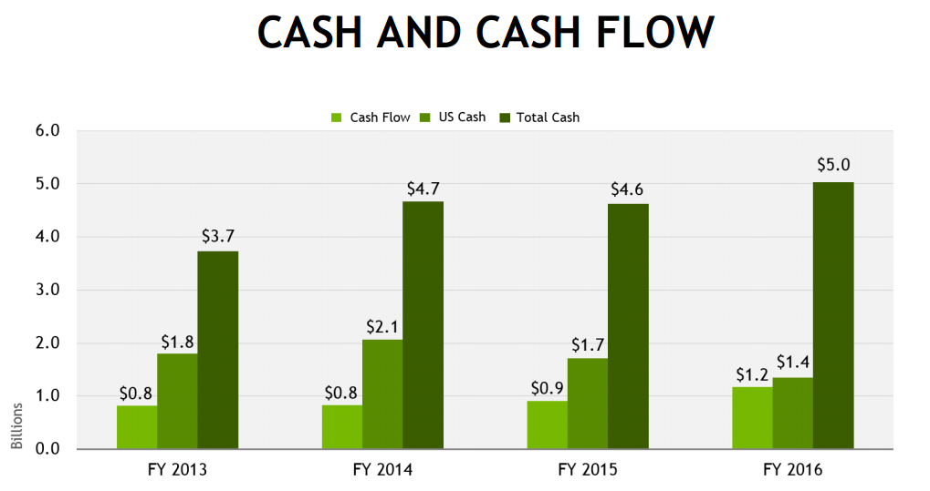
Financial Performance

Slide 13
Financial Performance

Slide 14
Financial Performance

Slide 15
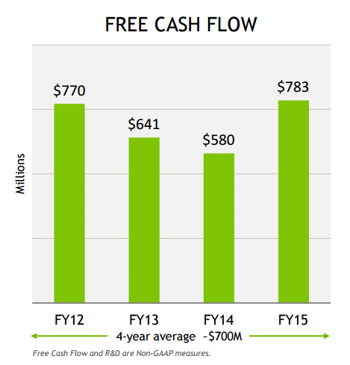
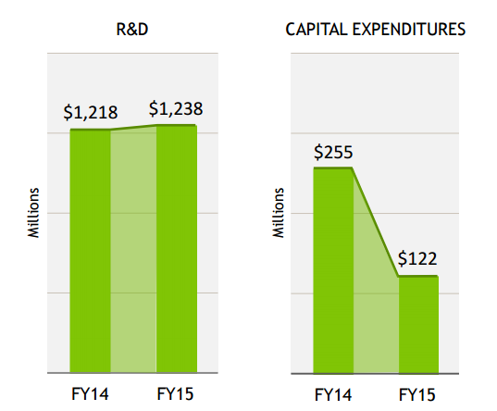
Financial Performance
What happened in 2014?
Again Nvidia’s market focus changed with changes to their management and spending

Slide 16


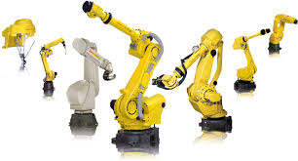
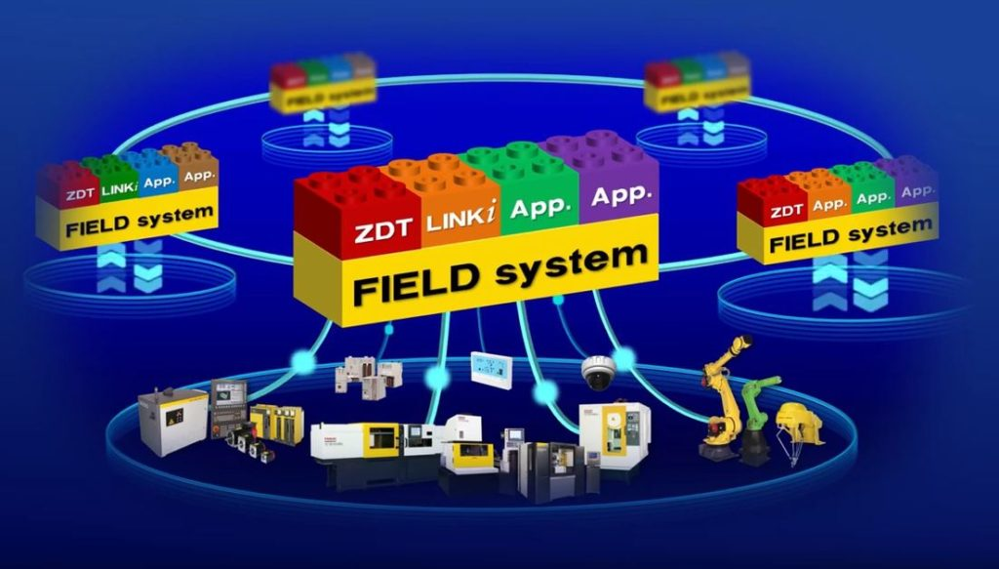
Current Events
10/4/2016
FANUC to Build Factory of the Future Using NVIDIA AI Platform
NVIDIA and FANUC Corporation in Tokyo, Japan collaborate to implement artificial in warehouses
system to increase robotics productivity and bring new capabilities to automated factories worldwide.

Slide 17
Valuation: DCF
Strong history of growing revenues and net income despite rising competition
Recent free up of cash flow
Conservative Growth Numbers
Continued global sales and presence
Valuation: $72.67
Model Weighting: 80%

Slide 18
Valuation: Comparables
AMD
Market Cap: $5.69 billion
Weighting: 35%
Intel Corp
Market Cap: $174.15 billion
Weighting: 30%
Qualcomm
Market Cap: $96.29 billion
Weighting: 35%
Valuation: $64.81
Model Weighting: 20%

Slide 19
Valuation: Historical
2017 Expected EPS
$1.47
Both 5 year and 3 year assumptions where both well below the current stock price
This could be attributed to the fact that the stock price moved so much this year
Intrinsic Value: $23.86
Weighting: 0%

Slide 20
Recommendation
Current Price: $66.85
Intrinsic Value: $71.56
Margin of Safety: 6.43%
Buy
Questions?

